Slide 1
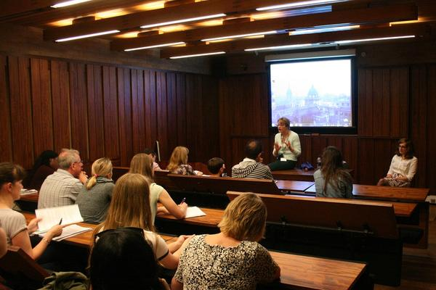
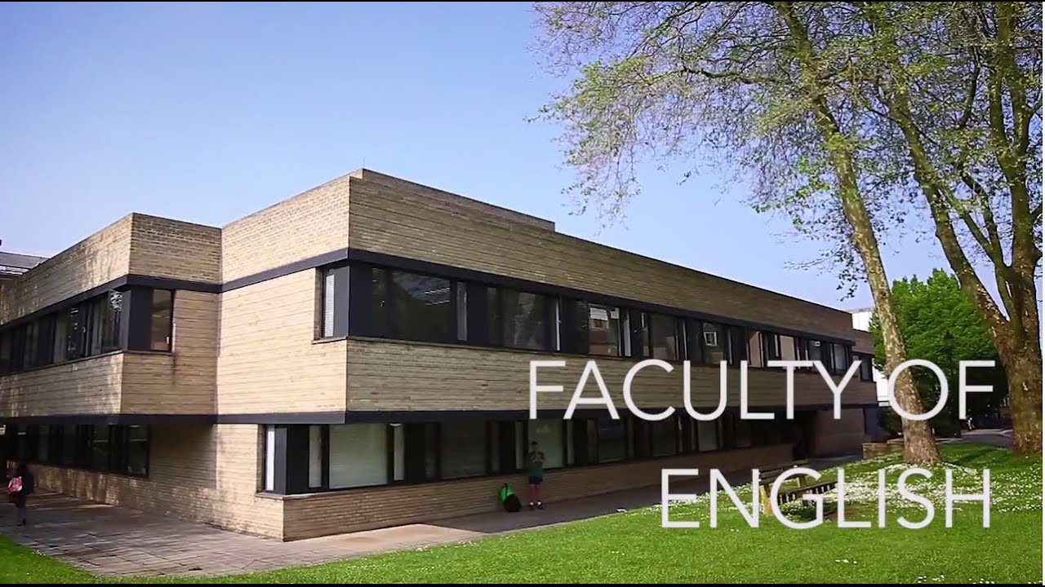
ADMISSIONS ENGLISH LANGAUAGE AND LITERATURE
Dr Lynn Robson
Director of Undergraduate Admissions
Fellow and Tutor in English, Regent’s Park College

Slide 2
Information
English Faculty Undergraduate Admissions
https://www.english.ox.ac.uk/prospective-undergraduates/admissions.html
University of Oxford Undergraduate Admissions and Outreach
https://www.ox.ac.uk/admissions/undergraduate

Slide 3
English Admissions 2021 (preliminary figures)
Applications:
State schools: 55%
Independent schools: 25%
Offers
State schools: 68% of total offers
Independent schools: 23% of total offers

Slide 4
English Admissions 2021 (preliminary figures)
Applications:
Female: 79.5%
Male: 20.5%
Offers
Female: 35.5% success rate
Male: 47.1% success rate

Slide 5
What degrees are there?
English Language and Literature
3 years
Year 1: Anglo-Saxon, Victorian, and Modern Literature; theories of language and literature
Year 2: Covers 1350-1760 in 3 separate modules or ‘papers’
Year 3: Students develop their own research studying Shakespeare, an option course, and a dissertation.
Exams at the end of Years 1 and 3
Notes:
Joint Schools available. C&E – no requirement to have studied an ancient language, or even Classical Civilisation. (4-yr degree.) Several modern languages can also be begun from scratch.
They have separate information on the website (next slide) and slightly different application procedures, for written work submission and tests. (Hist and English don’t sit the ELAT, but the HAT.)

Slide 6
Joint degrees
History and English
3 years
Study of language, texts, and culture, and the interactions of history and literature
Study of historical documents as ‘texts’, and using poetry, drama, and fiction as historically grounded ways of interpreting culture.
Several ‘bridge’ papers bringing together both parts of the degree
Notes:
Joint Schools available. C&E – no requirement to have studied an ancient language, or even Classical Civilisation. (4-yr degree.) Several modern languages can also be begun from scratch.
They have separate information on the website (next slide) and slightly different application procedures, for written work submission and tests. (Hist and English don’t sit the ELAT, but the HAT.)

Slide 7
Joint degrees
English and Modern Languages
4 years
Study of English literature alongside another literature, language, and culture.
Students choose from the range of courses available in each subject, and have opportunities to allow them to cross-fertilize.
Classics and English
3 or 4 years, depending on whether Latin or Greek has been studied to A-level.
Study of at least one ancient language.
Integrated course, with ‘bridge papers’ (eg Tragedy, Epic, Comedy, and Poetic Reception) in which both parts of the degree come together.
Notes:
Joint Schools available. C&E – no requirement to have studied an ancient language, or even Classical Civilisation. (4-yr degree.) Several modern languages can also be begun from scratch.
They have separate information on the website (next slide) and slightly different application procedures, for written work submission and tests. (Hist and English don’t sit the ELAT, but the HAT.)

Slide 8
Joint degrees
Anyone who applies to one of the joint degrees can opt to be considered for single honours degree as well.
Notes:
Joint Schools available. C&E – no requirement to have studied an ancient language, or even Classical Civilisation. (4-yr degree.) Several modern languages can also be begun from scratch.
They have separate information on the website (next slide) and slightly different application procedures, for written work submission and tests. (Hist and English don’t sit the ELAT, but the HAT.)

Slide 9
Academic ability and potential
Subject requirements
Particular backgrounds
Genuine subject interest
NO
YES
Irrelevant extra-curricular activities
Particular school types
Suitability for chosen course
www.ox.ac.uk/admissions/undergraduate/why-oxford/was-right-for-me
Notes:
What are we looking for?
A slide for myth busting!
Why Oxford was right for me
As part of a series in which well-known Oxford alumni tell us about their experiences. These testimonials may be useful to you– see the web link above.
http://www.ox.ac.uk/admissions/undergraduate/why-oxford/was-right-for-me
From university website (Jan 2016)
There are students from 140 countries and territories at Oxford. Almost 40% of our total student body - almost 8,900 students - are citizens of foreign countries, including 16% of undergraduates and 62% of graduate students.
Oxford is very competitive: around 18,300 people applied for around 3,200 undergraduate places for entry in 2015. That means that Oxford receives, on average, around five applications for each available place.
The majority of Oxford’s UK undergraduates come from state schools. Latest figures (entry 2014) show that, of places offered to British students attending schools or colleges in the UK, 56.3% of undergraduate places went to students from the state sector.
Equal opportunities statement The University of Oxford and its colleges seek to admit students of high academic ability and potential. All colleges select students for admission without regard to gender, marital or civil partnership status, disability, race, nationality, ethnic origin, religion or belief, sexual orientation, age or social background. Decisions on admission are based solely on the individual merits of each candidate and the application of selection criteria appropriate to the course of study. Admissions procedures are kept under review to ensure compliance with this policy.
CMA Guidance:
Factual inaccuracies:
e.g. “This is the largest <subject> department in the world.” How has this been verified? Can we be absolutely certain?
Please check all factual details you may use.

Slide 10
Choose course (and college, if you wish)
Start UCAS application
Test
registration
Submit application
By 15 October
Interview
Result of application
Written work / tests
Choose ‘firm’ and ‘insurance’ choices
Exam results/ confirmation
Start university!
www.ucas.com www.ox.ac.uk/apply
Notes:
9
How to apply
If you want to study at Oxford, you need to apply a year before the start date of your course by completing the online application form at www.ucas.com. Applications open in early September, and the deadline is 6pm UK time on 15 October every year.
You will need to provide information about yourself, including a personal statement where you talk about your interest in the subject or subjects you’re applying for (see our guidance on writing your personal statement). There is also a place where a teacher or advisor needs to give you a reference. This is all submitted through an online form – no additional references, transcripts, or certificates are required or accepted.
Most people apply to Oxford before they have finished their final year of school or college. If this is the case for you, then your referee will need to provide you with predicted grades – where they say what they expect you to achieve in your A-levels (or equivalent qualifications).
You may also need to register for a test or send in written work, depending on your chosen course. You will need to register separately for any tests, by a set date in October, and can normally sit them in your school or college, or at a centre near your home.
It is very important to make arrangements in good time, as your application may not be as competitive - or may not be considered at all - if you do not take any test or tests required for your course.
There is no separate Oxford application form, unless you are applying for:
Accelerated Medicine
If you have a science degree and are applying for the four-year Accelerated Medicine course, you must complete a supplementary application form, in addition to the UCAS application, to be submitted by 15 October.
Choral and Organ Awards
If you want to apply for a choral or organ award, you must complete an additional online application form by 1 September.
CMA guidance:
Factual inaccuracies:
e.g. “This is the largest <subject> department in the world.” How has this been verified? Can we be absolutely certain?
Please check all factual details you may use.

Slide 11
Qualifications
A level: AAA including English Literature, or English Language and Literature
IB: 38 with 666 at Higher Level, inc. English Literature
Pre-U: D3, D3, D3 inc. English Literature
Scottish Highers: AAAAB Highers supplemented with AA Advanced Highers, inc. English Literature

Slide 12
Application elements
UCAS form
Written work
ELAT
Interview
https://www.english.ox.ac.uk/what-we-look-for-undergraduate

Slide 13
Academic achievement
Admissions tests
Written work
UCAS personal statement
UCAS teacher’s reference
Interview
www.ox.ac.uk/outcomes
Notes:
Five of these refer to the pre-interview stage, and we use them to assess whom we should invite to interview. We take a holistic view of the application, we combine the components into a ranking/banding, and we take students into account. (Including the contextualised GCSE score.)
We use all of the information we have gathered about you to make a balanced and highly informed decision about whether to offer you a place.
Website (Jan 2016)
Decisions
Shortlisted candidates will be told whether or not their application has been successful in early January.
Tutors will make a decision based on:
your interview
any admissions tests or written work required for your course
your examination results and predicted grades
your personal statement
the academic reference
We receive many thousands of applications each year, and sadly many excellent candidates will not be offered places.
If you are made an offer, then it may be made by a particular college, or it may be 'open'. If you are currently studying for qualifications, then the offer will probably be 'conditional' on you achieving certain results; otherwise it will be 'unconditional', which means that there are no academic conditions and your place is guaranteed so long as you complete all the necessary administrative steps.
CMA guidance:
Factual inaccuracies:
e.g. “This is the largest <subject> department in the world.” How has this been verified? Can we be absolutely certain?
Please check all factual details you may use.
Beware of stating uniformly that no element counts more than another within the admissions selection process. In some subjects this could be the case.

Slide 14
UCAS form
October 15th deadline
Assessed by tutors in Colleges
Does the choice of College matter?

Slide 15
Personal Statement
Reasons for wanting to study English, or English with another subject
Independent reading interests
Critical engagement
Current studies
At least 80% of the statement on academic aspects
20% on extra-curricular activities

Slide 16
Reference
Performance against rest of cohort
Any relevant contexts
Academic potential

Slide 17
Written work
Shows us how students think and write
Work that shows them at their best
Attention to the literary aspects of texts
Sensitivity to the creative use of language
Evidence of careful and critical reading
An analytical approach
Coherence of argument and articulacy of expression
Precision, in the handling of concepts and in the evidence presented to support points
Relevance to the question
Independence of thought

Slide 18
Written work
Undergraduates write 1-2 essays per week
What kind of written work is it most useful for us to see?

Slide 19
ELAT: English Literature Admissions Test
Tests close reading
Shaping and articulating an informed response to unfamiliar literary material
90-minute test comparing two unseen passages from a choice of six, linked by a common theme
Preparation?
Registration
History and English: a separate test (HAT)
EML and CE: language tests as well
https://www.admissionstesting.org/for-test-takers/elat/about-elat/

Slide 20
Shortlisting
What information do we use?
How many do we shortlist?
Allocation to Colleges

Slide 21
Interviews
Why do we do interviews?
Format: usually two interviews, with 2 tutors interviewing
May have an interview at a second College
Preparation?

Slide 22
Interviews
Evidence of independent reading
Capacity to exchange and build on ideas
Clarity of thought and expression
Analytical ability
Flexibility of thought
Evidence of independent thinking about literature
Readiness and commitment to read widely with discrimination

Slide 23
Academic achievement
Admissions tests
Written work
UCAS personal statement
UCAS teacher’s reference
Interview
www.ox.ac.uk/outcomes
Notes:
Five of these refer to the pre-interview stage, and we use them to assess whom we should invite to interview. We take a holistic view of the application, we combine the components into a ranking/banding, and we take students into account. (Including the contextualised GCSE score.)
We use all of the information we have gathered about you to make a balanced and highly informed decision about whether to offer you a place.
Website (Jan 2016)
Decisions
Shortlisted candidates will be told whether or not their application has been successful in early January.
Tutors will make a decision based on:
your interview
any admissions tests or written work required for your course
your examination results and predicted grades
your personal statement
the academic reference
We receive many thousands of applications each year, and sadly many excellent candidates will not be offered places.
If you are made an offer, then it may be made by a particular college, or it may be 'open'. If you are currently studying for qualifications, then the offer will probably be 'conditional' on you achieving certain results; otherwise it will be 'unconditional', which means that there are no academic conditions and your place is guaranteed so long as you complete all the necessary administrative steps.
CMA guidance:
Factual inaccuracies:
e.g. “This is the largest <subject> department in the world.” How has this been verified? Can we be absolutely certain?
Please check all factual details you may use.
Beware of stating uniformly that no element counts more than another within the admissions selection process. In some subjects this could be the case.

Slide 24
Decision making
How successful is an applicant likely to be?

Slide 25
Opportunity Oxford
For applicants from under-represented backgrounds
Selected for the programme after interviews
Standard offer, identical degree programme, receive same tuition, assessed and awarded a degree on the same criteria as all students
Welcome Day
Bridging programme the summer before they begin their degree: online, and in-person

Slide 26
Opportunity Oxford
https://www.ox.ac.uk/admissions/undergraduate/increasing-access/opportunity-oxford

Slide 27
Foundation Oxford
UK state school students with high academic potential who have
Experienced severe personal disadvantage, or disrupted education
Free, fully-funded yearlong bespoke subject-specific course at Oxford
Generic and subject-specific skills
Development of academic and personal confidence
Up to 50 places per year
First cohort will be admitted in October 2023
https://www.ox.ac.uk/admissions/undergraduate/increasing-access/foundation-oxford

Slide 28
Working together Enthusing students to study English at A-level Encouraging students to think about Oxford, and then to apply Thinking about our admissions process

Slide 29
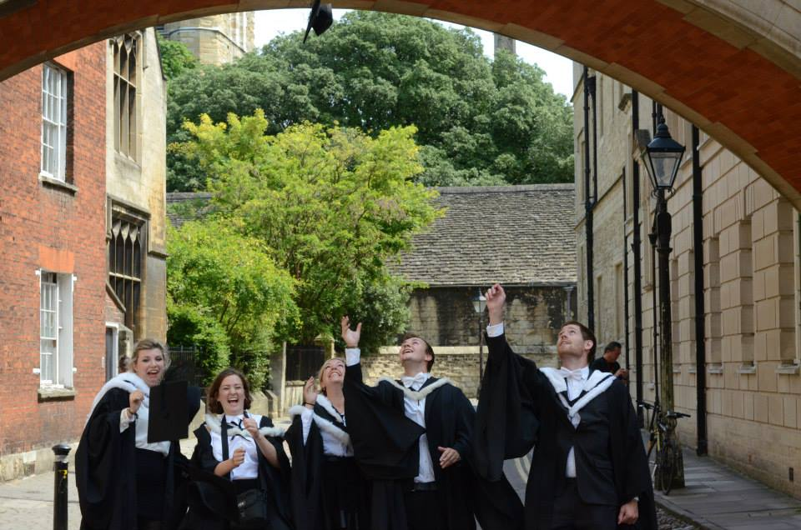
Thank you

