Slide 1
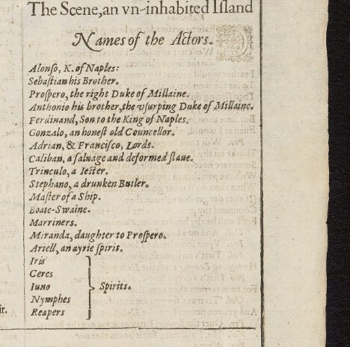
Shakespeare and Character
English Faculty, Oxford February 2021
Emma.smith@hertford.ox.ac.uk
@OldFortunatus

Slide 2
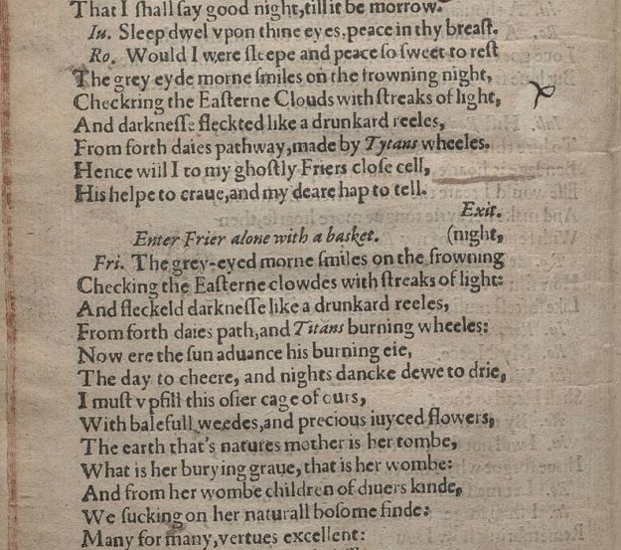
Romeo and Juliet (1599 edition)
(compare your teaching text)
(British Library Treasures Shakespeare in Quarto project)

Slide 3
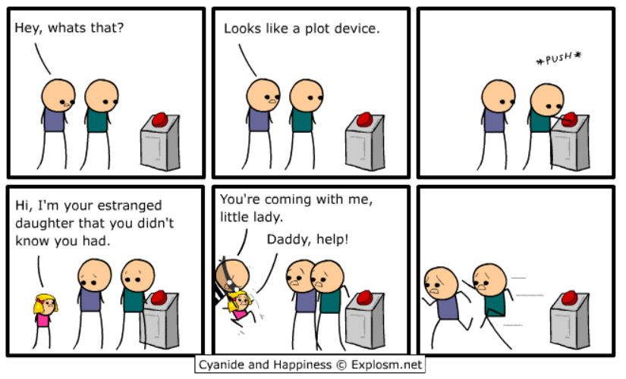
Characters as structural/thematic/plot devices
Fortinbras, Sebastian, Marina, Emilia
Characters who amplify the main character
Ophelia, Cordelia
Characters who are functional, or structural, or thematic – rather than psychological
Eg Fortinbras in Hamlet, Sebastian in Twelfth Night, Marina in Measure for Measure, Emilia in Othello
Characters can be plot devices

Slide 4
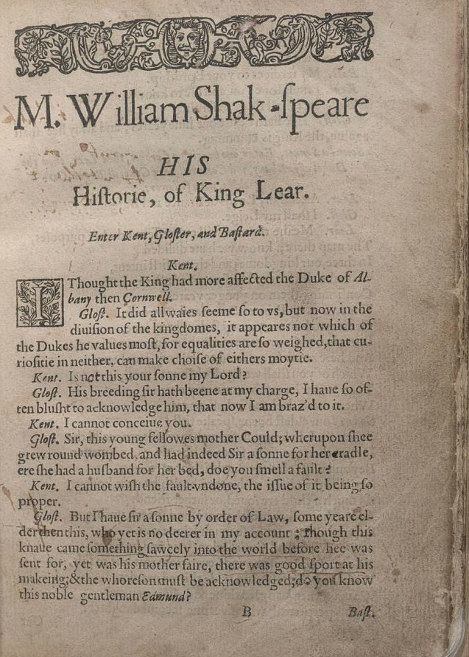
Names

Slide 5
Doubling

Slide 6
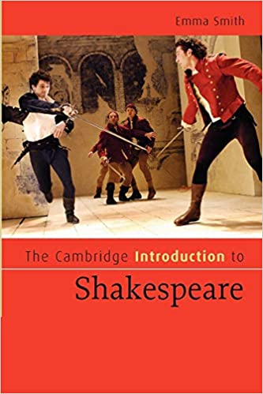
Lady Macbeth
I have given suck, and know
How tender ’tis to love the babe that milks me:
I would, while it was smiling in my face,
Have plucked my nipple from his boneless gums
And dashed the brains out, had I so sworn
As you have done to this. (1.7.54–9)
Harriet Walter: ‘it could have been a boy who died. This seemed to us the most likely
and contained the richest theatrical juice . . . to create the highest stakes possible
for the couple in this short but pivotal scene [1.7], we decided that the couple
had not spoken of the child since its death and that, for whatever reason, they
could not have any more’

Slide 7
From Emma Smith, The Cambridge Introduction to Shakespeare (2007)

Slide 8
Desdemona
Comedy?

Slide 9
Desdemona
Tragedy ?

Slide 10
Reframing the critical conversation
why does this character behave this way?
why does the play need this behaviour?
Why does he or she do what they do?
What would the play be like without them?

