Slide 1
Sherlock Holmes and Dorian Gray: Truth, Art and Immorality
Dr Sos Eltis, Brasenose College, University of Oxford

Slide 2
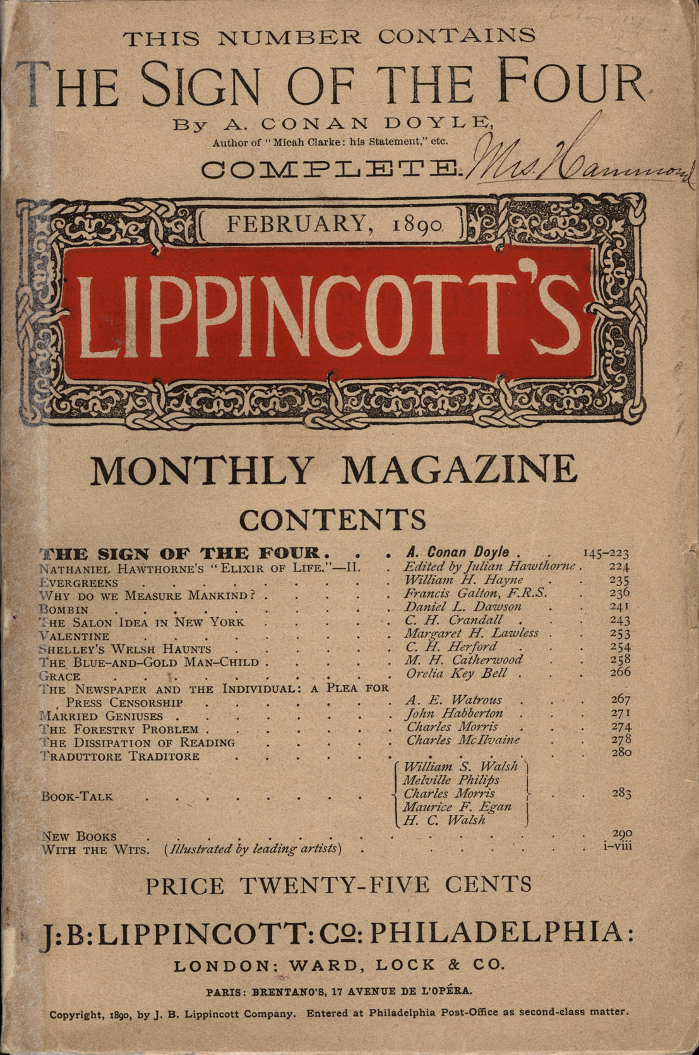
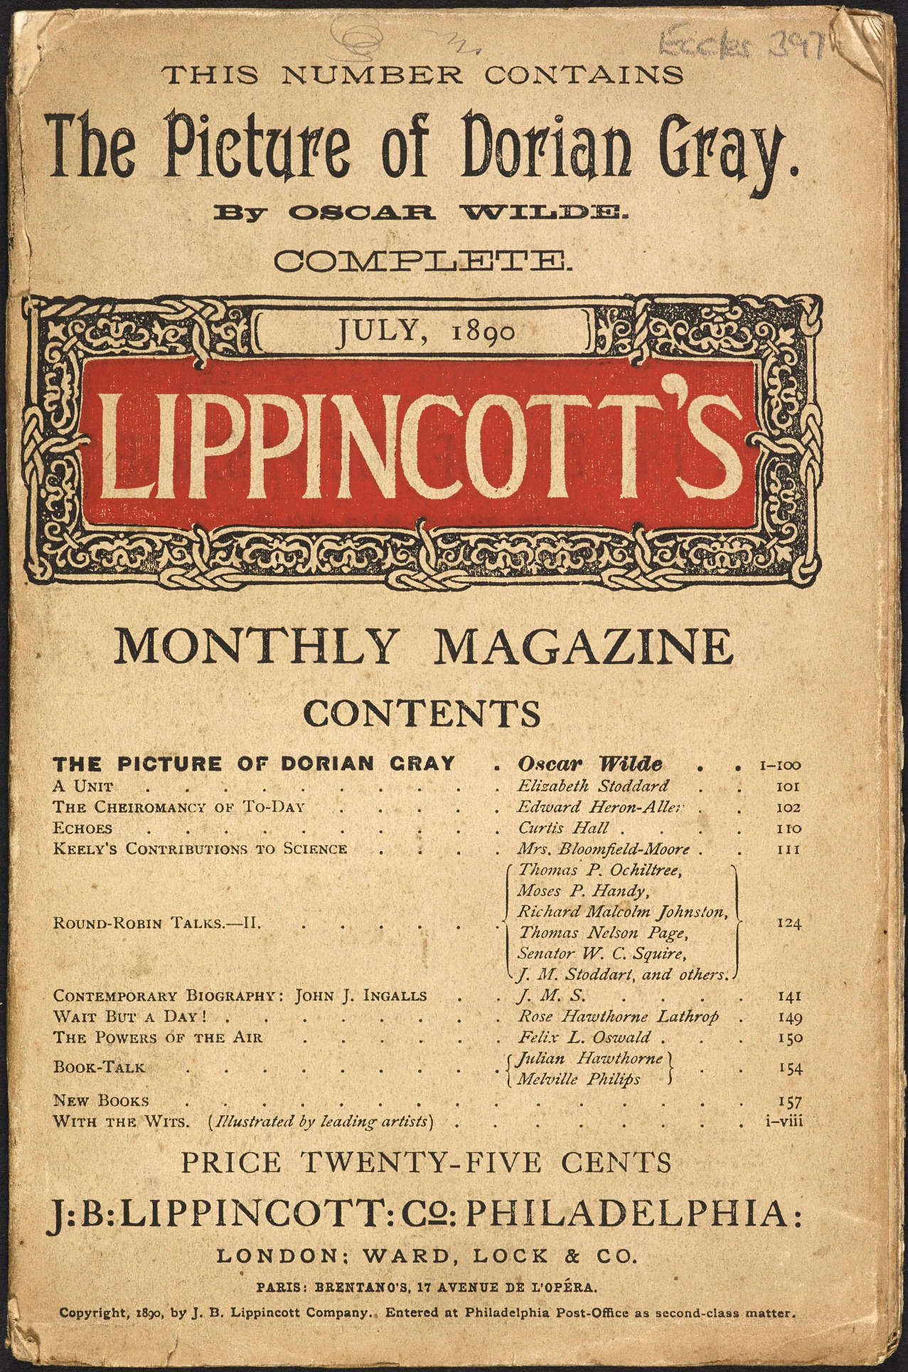

Slide 3
“The story—which deals with matters only fitted for the Criminal Investigation Department or a hearing in camera is discreditable alike to author and editor. Mr. Wilde has brains, and art, and style; but if he can write for none but outlawed noblemen and perverted telegraph boys, the sooner he takes to tailoring (or some other decent trade) the better for his own reputation and the public morals.”
(Daily Chronicle, 5 July 1890)

Slide 4
“. . . it is false art—for its interest is medico-legal; it is false to human nature—for its hero is a devil; it is false to morality—for it is not made sufficiently clear that the writer does not prefer a course of unnatural iniquity to a life of cleanliness, health, and sanity.”
(Daily Chronicle, 5 July 1890)

Slide 5
“It is a tale spawned from the leprous literature of the French Décadents—a poisonous book, the atmosphere of which is heavy with the mephitic odours of moral and spiritual putrefaction—a gloating study of the mental and physical corruption of a fresh, fair and golden youth, which might be horrible and fascinating but for its effeminate frivolity, its studied insincerity, its theatrical cynicism, its tawdry mysticism, its flippant philosophisings, and the contaminating trail of garish vulgarity which is over all Mr Wilde’s elaborate Wardour Street aestheticism and obtrusively cheap scholarship.”
(Daily Chronicle 30 June 1890)

Slide 6
‘Between two of the windows stood a large Florentine cabinet, made out of ebony and inlaid with ivory and blue lapis. He watched it as though it were a thing that could fascinate and make afraid, as though it held something that he longed for and yet almost loathed. . . . . [he] touched some hidden spring. A triangular drawer passed slowly out. His fingers moved instinctively towards it, dipped in, and closed on something. It was a small Chinese box of black and gold-dust lacquer, elaborately wrought, the sides patterned with curved waves, and the silken cords hung with round crystals and tasselled in plaited metal threads. He opened it. Inside was a green paste, waxy in lustre, the odour curiously heavy and persistent.’

Slide 7
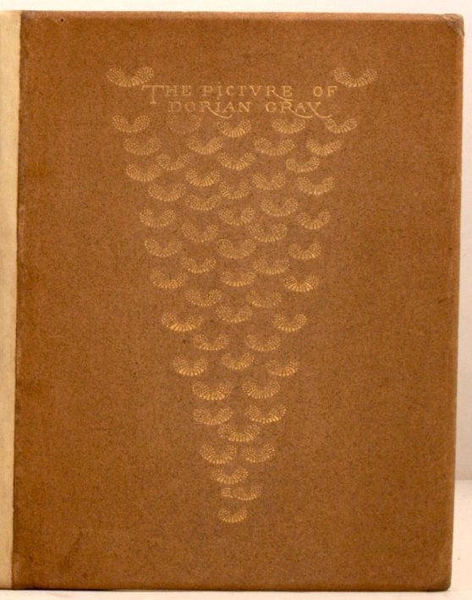
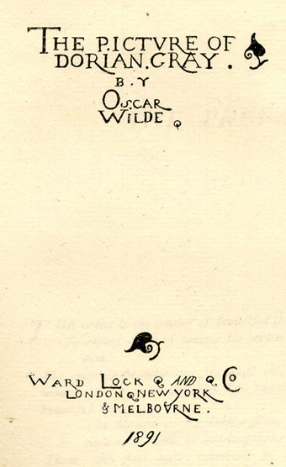

Slide 8
Could you not make Dorian live longer with the face of the picture transformed to himself and depict the nursery in which he ends his days by suicide or repents and becomes a better character. Lord Henry too goes off the scene very quickly. Could not he also live a little longer and you could make an excellent end that balances the deaths of the two men.
(George Lock, ‘To Oscar Wilde’, 7 July 1890, Clark Wilde MS L813L W6721. - qhp.xlix)

Slide 9
