Slide 1
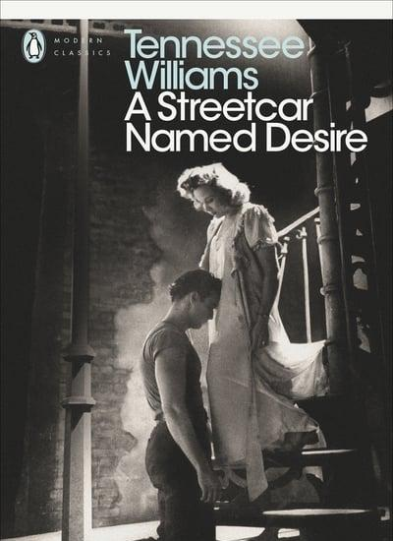
A Streetcar Named Desire: #MeToo and the Critics
Dr Sos Eltis
Brasenose College
English Faculty, Oxford

Slide 2
“[Blanche’s] sister and husband can now resume their happiness, proving Williams’s thesis that healthy life can go on only after it is rid of unwholesome influence. . .” Life, 15 Dec 1947

Slide 3
”For weeks she has been insulting and trying to attract him. When his wife is in the hospital having a baby, Blanche hysterically attacks him with the top of a broken bottle. In a half-drunken fury, Stanley rapes her.” Life, 15 Dec 1947

Slide 4
“Ben Foster, who plays Stanley, is the kind of seamy muscleman you might expect to find clearing your drains. But while it is important to condemn domestic violence, he needs some of Brando’s sex appeal to leaven the darker undercurrents.”
(Patrick Marmion, Daily Mail, 2020)

Slide 5
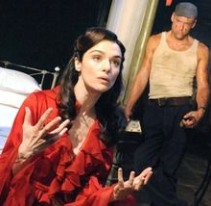
“A sister-in-law like this Blanche [Rachel Weisz] would send any man round the twist, but with an ogre such as Stanley the only surprise is that he does not explode sooner and more frequently.”
(Quentin Letts, Daily Mail, 2019)

Slide 6
“Streetcar is an extremely and peculiarly moral play, in the deepest and truest sense of the term. The rape of Blanche by Stanley is a pivotal, integral truth in the play, without which the play loses its meaning, which is the ravishment of the tender, the sensitive, the delicate, by the savage and brutal forces in modern society. It is a poetic plea for comprehension.”
(Tennessee Williams, letter to Joseph Breen)

Slide 7
In the uncut version, only a couple of shots are different - but what a difference they make! Stella's whole demeanor seems different, seems charged with lust. In the apartment, she responds more visibly to his voice. On the stairs, there are closeups as she descends, showing her face almost blank with desire. And the closing embrace, which looks in the cut version as if she is consoling him, looks in the uncut version as if she has abandoned herself to him. (Roger Ebert, 12 Nov 1993

Slide 8
Bonar Colleano and Vivien Leigh, Streetcar Named Desire, 1949, London premiere, directed by Laurence Olivier

Slide 10
“Out of poetic imagination and ordinary compassion he has spun a poignant and luminous story.”
(Brooks Atkinson, NY Times 1947)
“a brilliant, implacable play about the disintegration of a woman, or, if you like, of a society”
(Woolcott Gibbs, The New Yorker, 1947)

Slide 11
Some reviewers thought Blanche Du Bois a “boozy prostitute,” and others believed her a nymphomaniac. Such designations are not only inaccurate but reveal a total failure to understand the author’s intention and the theme of the play. Tennessee Williams is a poet of frustration, and what his play says is that aspiration, sensitivity, departure from the norm are battered, bruised, and disgraced in our world today.
‘It would be far truer to think of Blanche Du Bois as the potential artist in all of us than as a deteriorated Southern belle.
(Harold Clurman, New Republic, 1948)

Slide 12
‘Her amatory adventures, which her brother-in-law (like some of the critics) regards as the mark of her inferiority, are the unwholesome means she uses to maintain her connection with life, to fight the sense of death which her whole background has created in her. The play’s story show us Blanche’s seeking haven in a simple, healthy man and that in this, too, she is defeated because everything in her environment conspires to degrade the meaning of her tragic situation. . . . Her lies are part of her will-to-beauty; her wretched romanticism is a futile reaching toward a fullness of life. She is not a drunkard, and she is not insane when she is committed to an asylum. She is an almost willing victim of a world that has trapped her and in which she can find “peace” only by accepting the verdict of her unfitness for “normal” life.

Slide 13
[Stanley] is the embodiment of animal force, of brute life unconcerned and even consciously scornful of every value that does not come within the scope of such life. He resents being called a Polack, and he quotes Huey Long, who assured him that “every man is a king.” He screams that he is a hundred per cent American, and breaks dishes and mistreats his women to prove it. He is all muscle, lumpish sensuality, and crude energy, given support by a society that hardly demands more of him. He is the unwitting antichrist of our time, the little man who will break the back of every effort to create a more comprehensive world in which thought and conscience, a broader humanity are expected to evolve from the old Adam. His mentality provides the soil for fascism, viewed not as a political movement but as a state of being.
(Harold Clurman, 1948)

Slide 14
“To present it all as mere pretense is to turn Blanche into another self-serving struggler in a Darwinian world. She, too, to use her words, has come to ‘hang back with the brutes.’”
(Ben Brantley, NY Times, 2004)

Slide 15
“she has the intelligence, the wry humour, the yearning for love and the capacity to express it, the warmth and the radiance thwarted by circumstances: indeed, the key qualities that make her Williams’s most striking creation.” (Benedict Nightingale, Times, 2009)

Slide 16
“the assaults and sex normally left off stage – invest this Streetcar with fresh, raw power, particularly exploring the disturbing fine line between ardour and domestic abuse in Stanley and Stella’s relationship. ‘[Vanessa] Kirby’s lissome Stella is strikingly libidinous with a masochistic streak” (Kate Bassett, Times, 2014)

Slide 17
He felt his way under her skin because, in a sense, he was Blanche DuBois himself: a Southerner with a nostalgia for the Eden he believed had been ruined by the crude and brutal, a gay man in whom a hankering for purity clashed with a taste for rough trade.”
(Benedict Nightingale, Times, Oct 2002)
“My own view is that Williams has ventriloquised and heterosexualised his own sensibilities into Blanche: this is a fictional variant of a gay man doing the tense bickering and bantering with a half-naked Stanley and, perhaps, delicately kissing a young boy on the lips. Only in this context can you understand Stanley’s puzzled unease and contempt.”
(Peter Bradshaw, Guardian, Feb 2020)

